Slide 1
Devops
Ahtisham Shakir (2019-ag-6053)
Talha Azeem (2019-ag-6072)
Numan Khan (2019-ag-6073)

Slide 2
Basic Overview
The word Devops made up of two words Development plus Operations
Devops is a software development strategy which is used to minimize the gap between development team and operations team.
IMPORTANT TO KNOW : Devops is neither a technology nor a tool. It is just a methodology.

Slide 3
Waterfall Model
Before the existence of devops all companies use waterfall model for building applications.
This method follows linear approach.
Application goes to the next stage only if its previous stage is completed.
Application cannot go back to the previous stage.

Slide 4
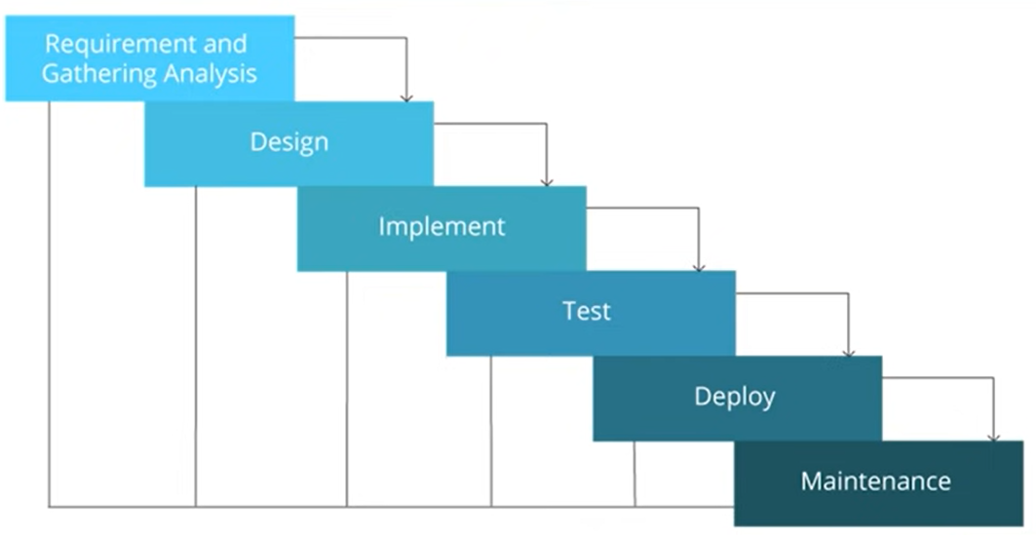
Stages in waterfall Model

Slide 5
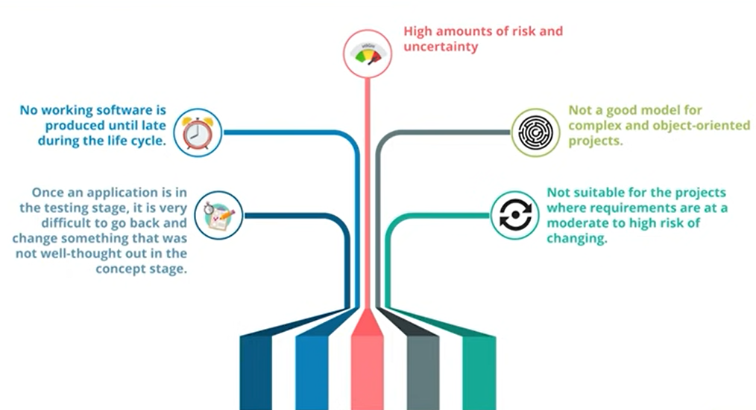
Limitations

Slide 6
Agile Methodology
In Agile methodology each project is broken up into several iterations.
All iteration should be of the same duration (between 2 – 8 weeks).
At the end of each iteration a working product should be delivered.

Slide 7
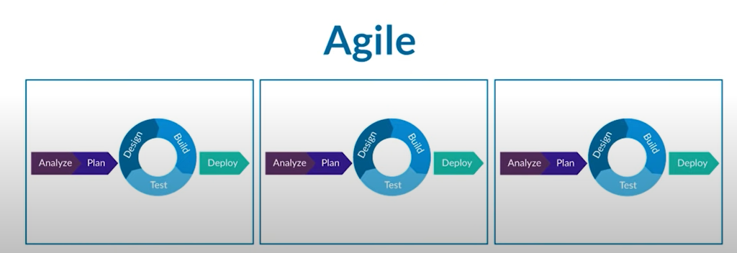
Agile Method iterations

Slide 8
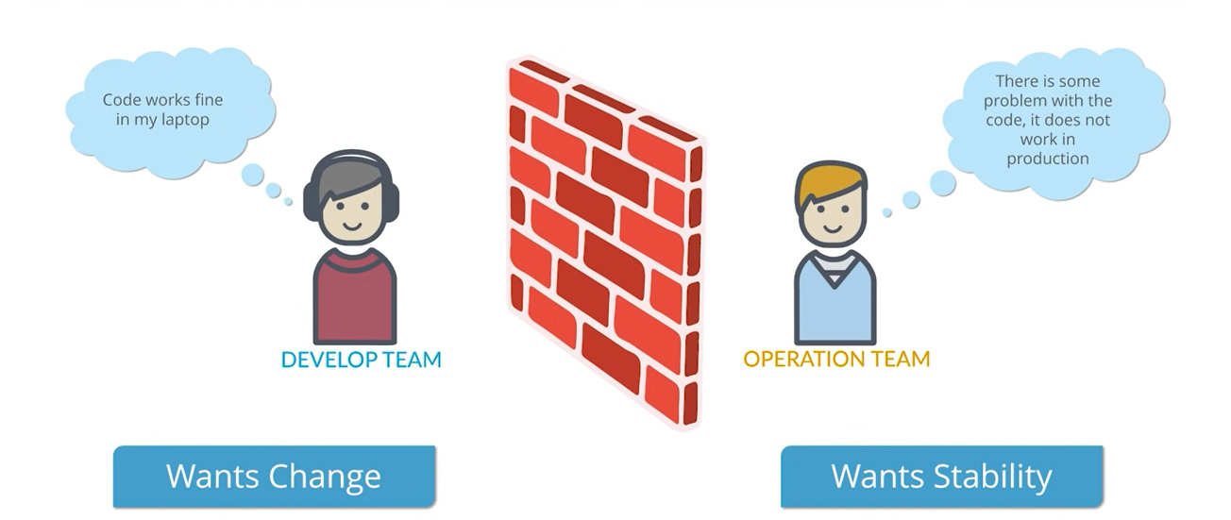
Limitations

Slide 9
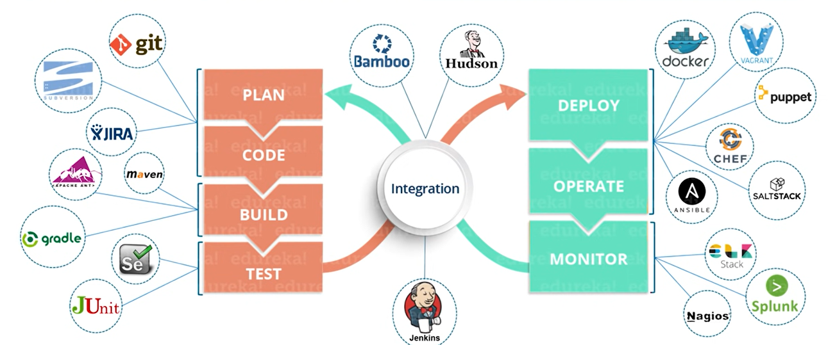
Devops
Devops is a software development strategy which is used to minimize the gap between development team and operations team.
Dev side and Ops side equally participate in software development environment.

Slide 10
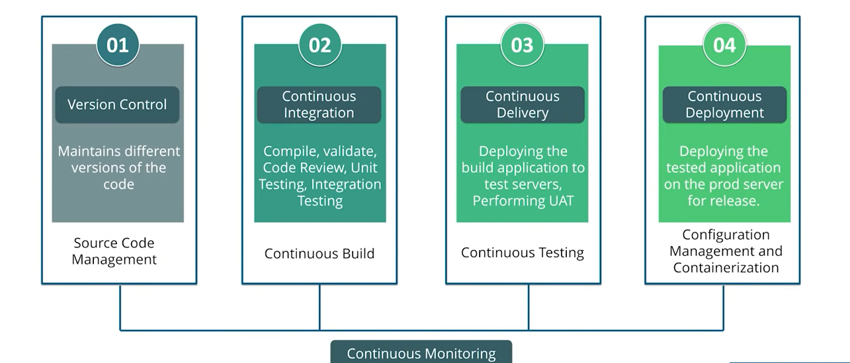
Devops Stages

Slide 11
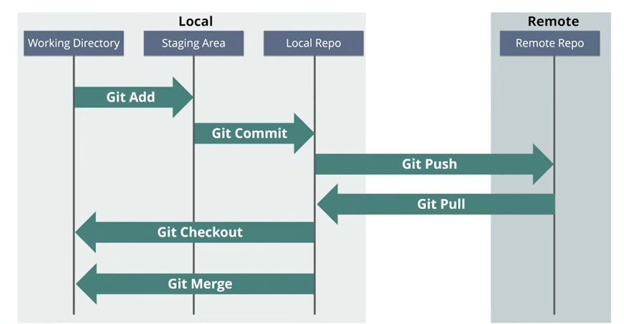
Source Code Management
In this stage we maintain different versions of our code.
In this stage we use git for source code management.
Git is a distributed version control system.
Every developer has its own copy of original code in local repository.
They can make changes in remote repository.

Slide 12
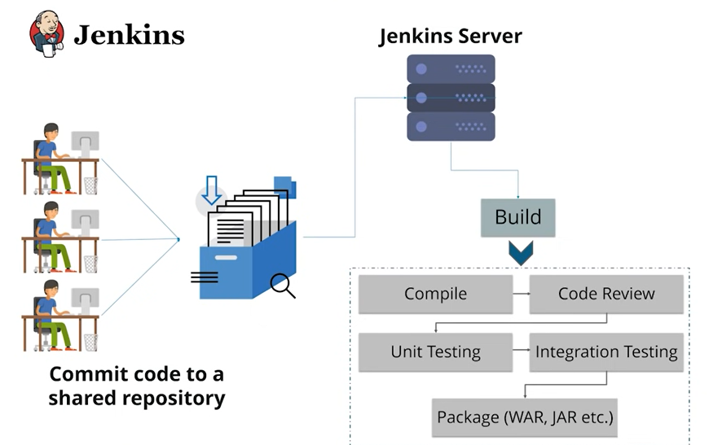
Continuous Integration
Jenkins server is use in this stage.
Developers commit code in one shared repository.
When ever developer commit Jenkins server pull code and perform build.
Jenkins server provide 2500+ plugins to perform these functionalities.

Slide 13
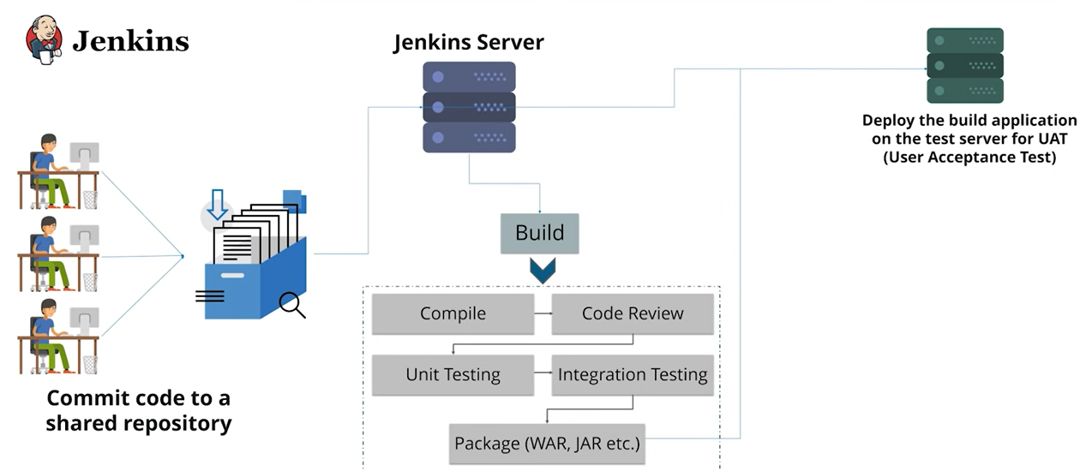
Continuous Delivery
It is the next stage of continuous integration.
We continuously deploy our build application on test servers for UAT( User Acceptance Test ).

Slide 14
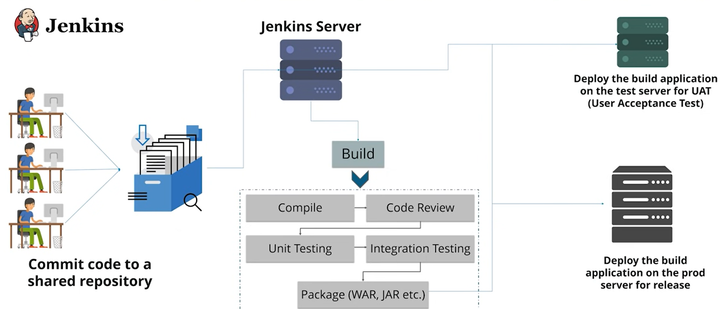
Continuous Deployment
We continuously deploy our build application on the production server for release.

Slide 15
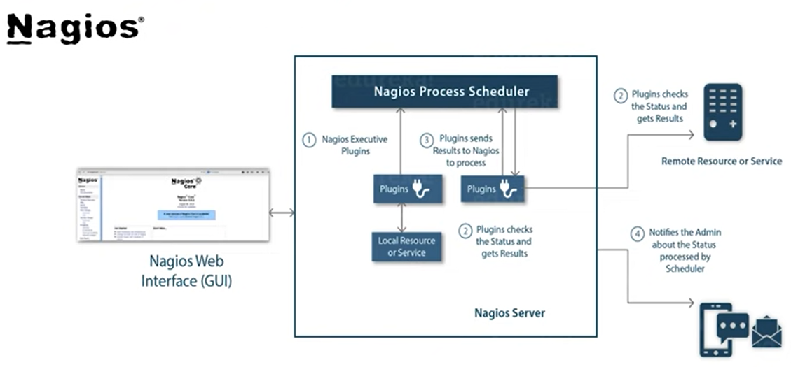
Continuous Monitoring
We use Nagios for continuously monitor all the stages.
Nagios is very convenient because it provide dashboard for monitoring our stages.

Slide 16
Disadvantages of Devops
Devops professionals or expert developers are less available.
Developing with devops is so expensive.
Adopting new devops technology into the industries is hard to manage in short time.
Lack of devops knowledge can be a problem.

Slide 17
Research Paper
DevOps is an approach based on lean and agile principles in which business, development, operations, and quality teams cooperate to deliver software continuously aiming at reducing time to market, and receiving constant feedback from customers. However, implementing DevOps can be a complex and challenging mission due it requires signiﬁcant paradigm shift. Consequently, many failures and misconceptions can occur about DevOps adoption by organizations, despite its numerous beneﬁts.
Source :
https://www.academia.edu/78920997/DevOps_Adoption_Eight_Emergent_Perspectives

